Slide 1
Chapter 5. Basic Processing Unit

Slide 2
Some Fundamental Concepts
Program: consists of a series of operations specified by a sequence of machine-language instructions.
The processor fetches one instruction at a time and performs the operation specified.
Instructions are fetched from successive memory locations until a branch or a jump instruction is encountered.
The processor uses the program counter, PC, to keep track of the address of the next instruction to be fetched and executed.
After fetching an instruction, the contents of the PC are updated to point to the next instruction in sequence.

Slide 3
A branch instruction may cause a different value to be loaded into the PC.
When an instruction is fetched, it is placed in the instruction register, IR.
Then it is interpreted, or decoded, by the processor’s control circuitry.
The IR holds the instruction until its execution is completed.

Slide 4
Steps to be performed - Instruction
Fetch Phase
Fetch the contents of the memory location pointed to by the PC. The contents of this location are loaded into the IR (fetch phase).
IR ← [[PC]]
Assuming that the memory is byte addressable, increment the contents of the PC by 4 (fetch phase).
PC ← [PC] + 4
Carry out the actions specified by the instruction in the IR (execution phase).

Slide 5
Instruction execution phase
With few exceptions, the operation specified by an instruction can be carried out by performing one or more of the following actions:
Read the contents of a given memory location and load them into a processor register.
Read data from one or more processor registers.
Perform an arithmetic or logic operation and place the result into a processor register.
Store data from a processor register into a given memory location.

Slide 6
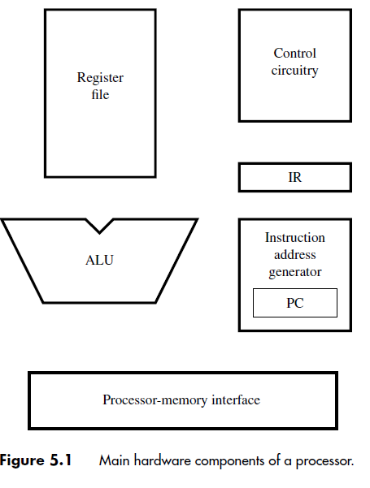
Hardware components Needed

Slide 7
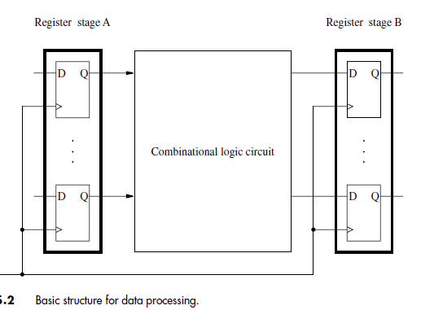
Data Processing Hardware
Processing is a procedure that transforms raw data into some meaningful information.

Slide 8
The operation performed by the combinational block may be quite complex.
It can often be broken down into several simpler steps, where each step is performed
by a sub circuit of the original circuit.
These sub circuits can then be cascaded into
multistage structure

Slide 9
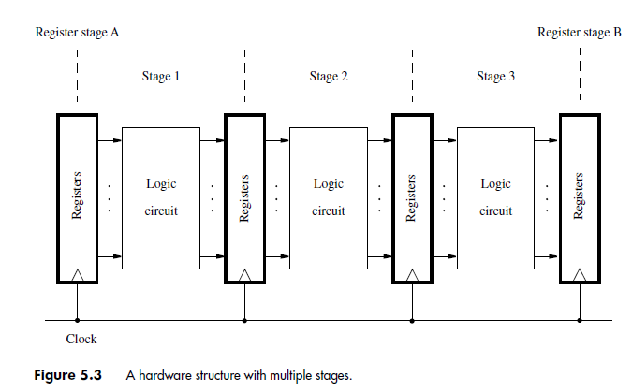

Slide 10
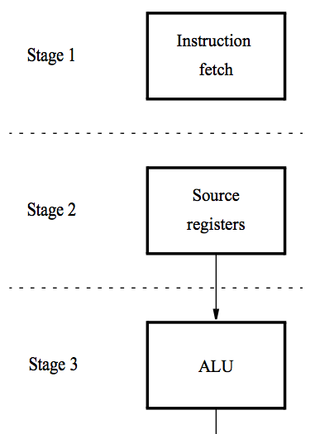
A 5-stage implementation of a RISC processor
Instruction processing moves from each stage to the next in every clock cycle.
The instruction is decoded and the source registers are read in stage 2.
Computation takes place in the ALU in stage 3.

Slide 11
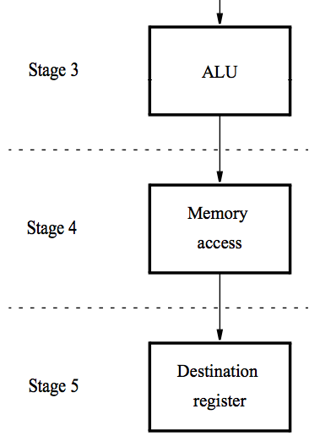
A 5-stage implementation of a RISC processor
If a memory operation is involved, it takes place in stage 4.
The result of the instruction is stored in the destination register in stage 5.

Slide 12
Instruction Execution
Actions involved in fetching and executing instructions.
Illustration of actions using a few representative RISC style instructions.

Slide 13
Load Instructions
Eg: Load R5, X(R7)
which uses the Index addressing mode to load a word of data from memory location X + [R7] into register R5.
Execution of this instruction involves the following actions:
Fetch the instruction from the memory.
Increment the program counter.
Decode the instruction to determine the operation to be performed.
Read register R7.
Add the immediate value X to the contents of R7.

Slide 14
Use the sum X + [R7] as the effective address of the source operand, and read the contents of that location in the memory.
Load the data received from the memory into the destination register, R5.

Slide 15
Depending on how the hardware is organized, some of these actions can be performed at the same time.
Execution of each instruction is divided into five steps, such that each step is carried out by one hardware stage.
Fetching and executing the Load instruction above can be completed as follows:

Slide 16
1. Fetch the instruction and increment the program counter.
2. Decode the instruction and read the contents of register R7 in the register file.
3. Compute the effective address.
4. Read the memory source operand.
5. Load the operand into the destination register, R5.

Slide 17
Arithmetic and Logic Instructions
A typical instruction of this type is Add R3, R4, R5
1. Fetch the instruction and increment the program counter.
2. Decode the instruction and read the contents of source registers R4 and R5.
3. Compute the sum [R4] + [R5].
4. No Action
5. Load the result into the destination register, R3.

Slide 18
Add R3, R4, #1000
2 Decode the instruction and read register R4.
3. Compute the sum [R4] + 1000.

Slide 19
Store Instructions
Store R6, X(R8)
1.Fetch the instruction and increment the program counter.
2. Decode the instruction and read registers R6 and R8.
3. Compute the effective address X + [R8].
4. Store the contents of register R6 into memory location X + [R8].
5. No action.

Slide 20
A five-step sequence of actions to fetch and execute an instruction
Step Action
1 Fetch an instruction and increment the program counter.
2 Decode the instruction and read registers from the register file.
3 Perform an ALU operation.
4 Read or write memory data if the instruction involves a memory operand.
5 Write the result into the destination register, if needed.

Slide 21
Hardware Components
RISC-style processor can be executed
using the five-step sequence.
Hence, the processor hardware may be
organized in five stages, such that each stage performs the actions needed in one of the steps.

Slide 22
Register File
General-purpose registers
a small and fast memory block.
consists of an array of storage elements, with access circuitry that enables data to be read from or written into any register.
The access circuitry is designed to enable two registers to be read at the same time, making their contents available at two separate outputs, A and B.

Slide 23
These inputs are connected to the fields in the IR that specify the source registers.
The register file also has a data input, C
This address input is connected to the IR field that specifies the destination register of the instruction.
Dual ported

Slide 24
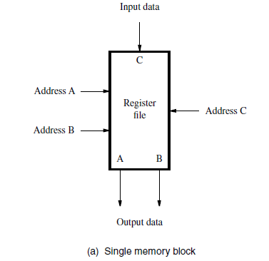

Slide 25
To use a single set of registers with duplicate data paths and access circuitry that enable two registers to be read at the same time.

Slide 26
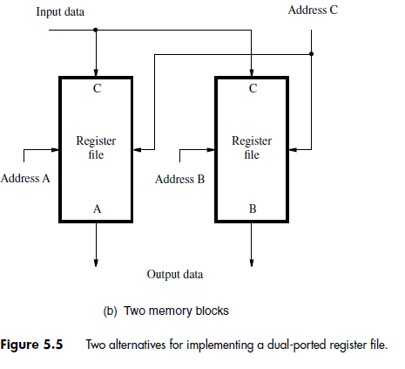

Slide 27
An alternative is to use two memory blocks, each containing one copy of the register file.
Whenever data are written into a register, they are written into both copies of that register.

Slide 28
The two files have identical contents.
When an instruction requires data from two registers, one register is accessed in each file.
In effect, the two register files together function as a single dual-ported register file.

Slide 29
ALU
The arithmetic and logic unit is used to manipulate data.
AL operations
Conceptually, the register file and the ALU may be connected.

Slide 30
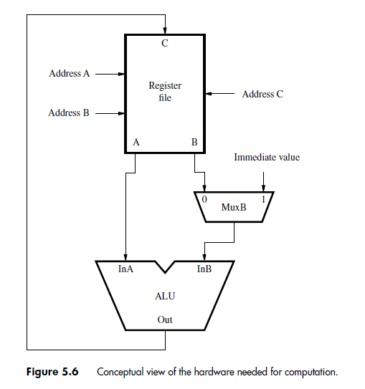

Slide 31
Datapath
Fetch phase and the execution phase
Fetch: Responsible for decoding them and for generating the control signals that cause appropriate actions to take place in the execution section.
Execution section reads the data operands
specified in an instruction, performs the required computations, and stores the results.

Slide 32
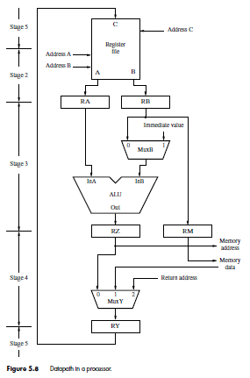

Slide 33
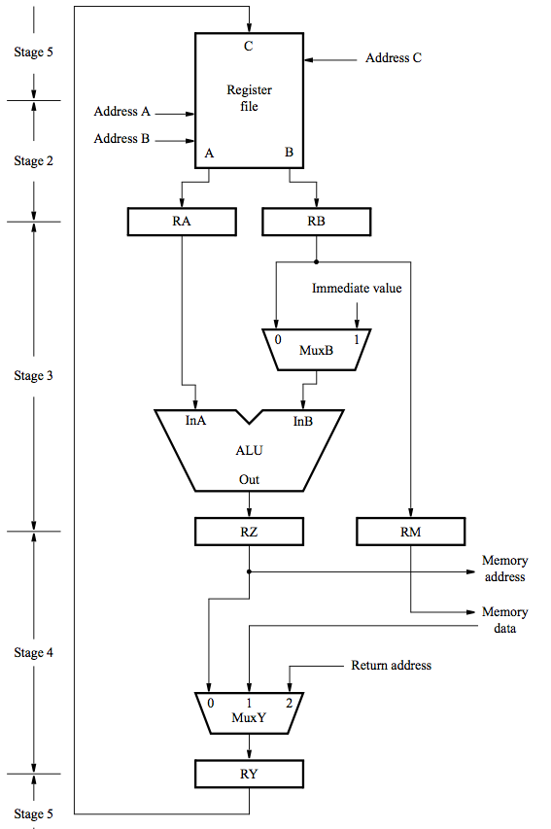
Example: Add R3, R4, R5
Memory address ← [PC], Read memory, IR ←Memory data, PC ← [PC] + 4
Decode instruction,
RA ← [R4], RB ← [R5]
RZ ← [RA] + [RB]
RY ← [RZ]
R3 ← [RY]

Slide 34
Example: Load R5, X(R7)
Memory address ← [PC],
Read memory, IR ← Memory data, PC ←[PC] + 4
Decode instruction, RA ←[R7]
RZ ←[RA] + Immediate value X
Memory address ←[RZ], Read memory, RY ← Memory data
R5 ←[RY]

Slide 35
Example: Store R6, X(R8)
Memory address ←[PC], Read memory, IR ← Memory data, PC ← [PC] + 4
Decode instruction,
RA ←[R8], RB ←[R6]
RZ ←[RA] + Immediate value X, RM ←[RB]
Memory address ←[RZ], Memory data ←[RM], Write memory
No action

Slide 36
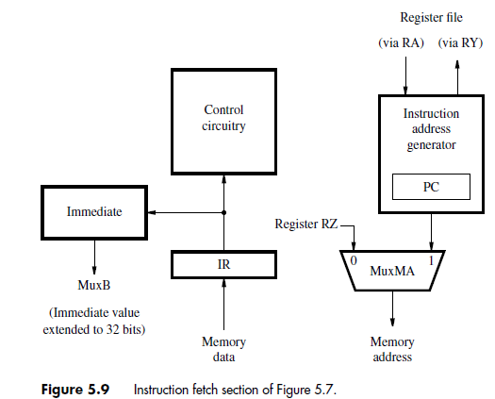
Instruction Fetch Phase

Slide 37
PC contains the address of the next instruction to be fetched. i.e. to fetch an instruction from the memory address come from PC.
Similarly to fetch memory operands address comes from register RZ in the data path.
To select the address of either instruction or operand use mux MA.
The PC is included in the larger block i.e. instruction address generator, which updates the contents of PC after each instruction is fetched.

Slide 38
The instruction read from the memory is loaded in to IR, where it stays until it’s execution is completed and next instruction is fetched.
The content of IR is examined by the control circuitry a to generate the signals needed to control all the processors hardware.
Sometimes instruction may include an immediate value.
The address generator circuit uses an adder to increment the PC by 4 during the straight line execution. It is used to compute the new value to be loaded in to PC.

Slide 39
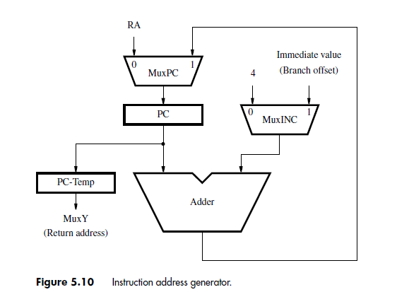

Slide 40
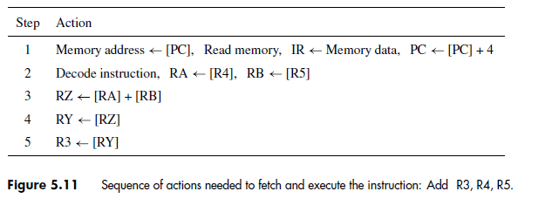
Instruction Fetch and Execution Steps

Slide 41
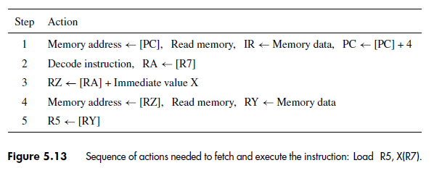

Slide 42
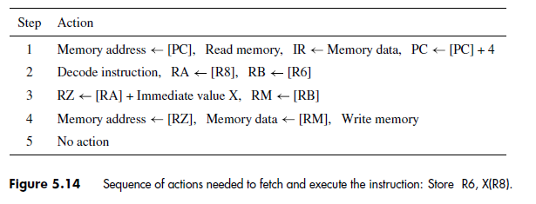

Slide 43
Branching

Slide 44
Branching - Unconditional
Branching
Branch instructions specify the branch target address relative to the PC
A branch offset given as an immediate value in the instruction is added to the current contents of the PC.
Branch offset: Distance between the branch target and memory location following the branch instruction.

Slide 45
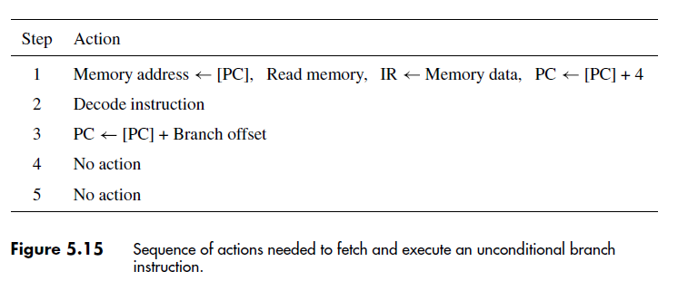
Steps for implementing an unconditional branch instruction

Slide 47
Conditional Branch
Branch Target: Distance between the branch target and memory location following the branch instruction.
Branch instruction specifies a compare-and-test operation that determines the branch condition.
Branch_if_[R5]=[R6] LOOP
results in a branch if the contents of registers R5 and R6 are identical.
Comparison by subtraction

Slide 48
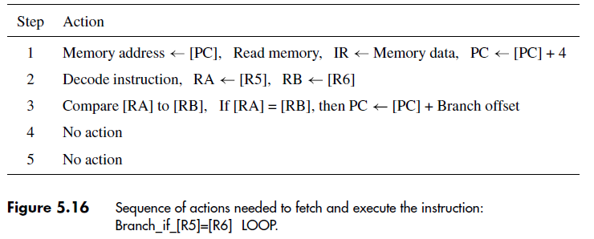

Slide 49
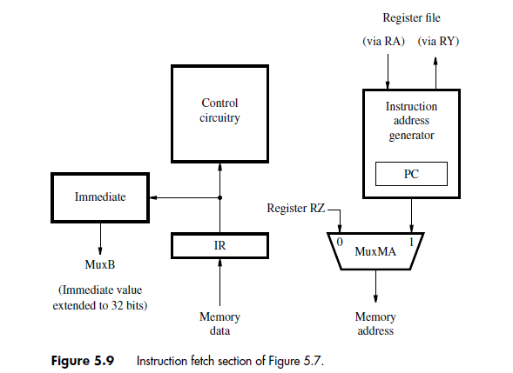

Slide 50
Subroutine Call Instructions
Subroutine calls and returns are implemented in a similar manner to branch instructions.
The address of the subroutine may either be computed using an immediate value given in
the instruction or
it may be given in full in one of the general-purpose registers

Slide 51
Call_Register R9
which calls a subroutine whose address is in register R9

Slide 52
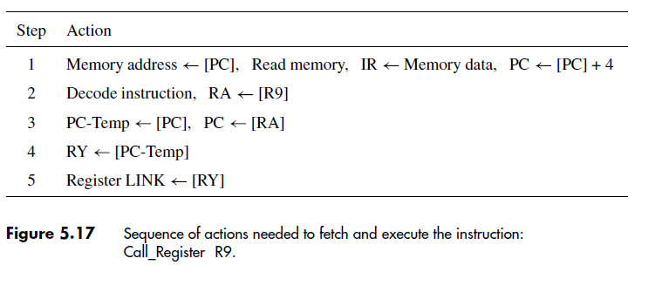

Slide 53
The contents of that register are read and placed in RAin step 2.
During step 3, multiplexer MuxPC selects its 0 input, thus transferring the data in register RA to be loaded into the PC.
The return address of the subroutine, which is the previous contents of the PC, is to be saved in a general-purpose register called LINK in the register file.

Slide 54
To maintain correct data flow in the five-stage structure,
the processor saves the return address in a temporary register, PC-Temp.

Slide 56
Wait For Memory

Slide 57
Waiting for Memory
Processor-memory interface circuit: to control data transfers between the processor and the memory.
modern processors use fast, on-chip cache memories.
the instruction or data referenced in memory Read and Write operations are found in the cache – One clock Cycle
Otherwise,several clock cycles may be needed

Slide 58
The interface circuit must inform the processor’s control circuitry about such situations.
to delay subsequent execution steps until the memory operation is completed.
processor-memory interface circuit generates a signal called Memory Function Completed (MFC).
If data is in the cache, instruction execution continues uninterrupted.

Slide 59
Step1: of the execution sequence of any instruction involves fetching the instruction
from the memory.
Therefore, it must include a Wait for MFC command, as follows:
Memory address←[PC], Read memory, Wait for MFC,
IR← Memory data, PC←[PC] + 4
Similarly in step4 for LOAD and STORE, if memory access is involved.

Slide 60
Control Signals

Slide 61
Control Signals
The operation of the processor’s hardware components is governed by control signals.
These signals determine which multiplexer input is selected, what operation is performed by the ALU, and so on.

Slide 62
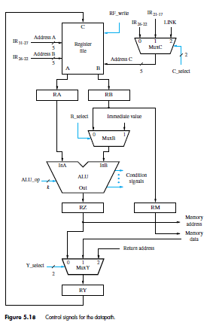

Slide 63
Hardwired Control
How the processor generates the control signals that cause these actions to take place in the correct sequence and at the right time.
There are two basic approaches:
Hardwired Control
Micro- programmed Control
An instruction is executed in a sequence of steps, where each step requires one clock cycle.

Slide 64
Hence, a step counter may be used to keep track of the progress of execution.
Several actions are performed in each step, depending on the instruction being executed.

Slide 65
The setting of the control signals depends on:
Contents of the step counter
Contents of the instruction register
The result of a computation or a comparison operation
External input signals, such as interrupt requests

Slide 66
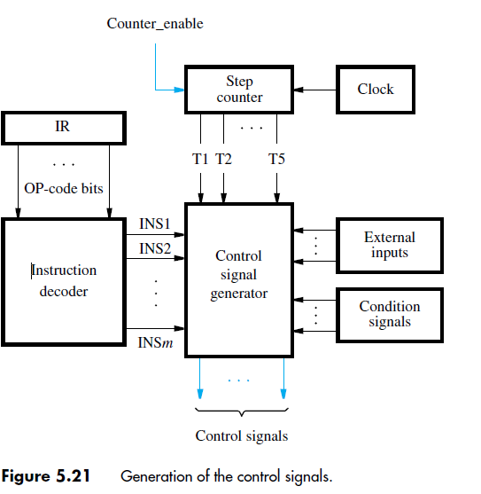
Hardwired Control

Slide 67
The instruction decoder interprets the OP-code and addressing mode information in the IR and sets to 1 the corresponding INSi output.
During each clock cycle, one of the outputs T1 to T5 of the step counter is set to 1 to indicate which of the five steps. modulo-5 counter may be used.
The control signal generator is a combinational circuit that produces the necessary control signals based on all its inputs.

Slide 69
Data path Control Signals
Once an instruction is loaded into the IR, the instruction decoder interprets its contents to determine the actions needed
At the same time, the source registers are read and their contents become available at the A and B outputs of the register file.
As mentioned earlier, inter-stage registers RA, RB, RZ, RM, and RY are always enabled.
This means that data flow automatically from one datapath stage to the next on every active edge of the clock signal.

Slide 70
The desired setting of various control signals can be determined by examining the actions taken in each execution step of every instruction.
For example, the RF_write signal is set to 1 in step T5 during execution of an instruction that writes data into the register file.
It may be generated by the logic expression
RF_write = T5 ・ (ALU + Load + Call)

Slide 71
where ALU stands for all instructions that perform arithmetic or logic operations,
Load stands for all Load instructions, and Call stands for all subroutine-call and software-interrupt instructions

Slide 72
Dealing with Memory Delay
The timing signals T1 to T5 are asserted in sequence as the step counter is advanced.
Most of the time, the step counter is incremented at the end of every clock cycle.
in which a MEM_read or a MEM_write command is issued does not end until the MFC signal is asserted, indicating that the requested memory operation has been completed.

Slide 73
To extend the duration of an execution step to more than one clock cycle, we need to disable the step counter.
Assume that the counter is incremented when enabled by a control signal called Counter_enable.
Let the need to wait for a memory operation to be completed be indicated by a control signal called WMFC, which is activated during any execution step in which the Wait for MFC command is issued
Counter_enable = WMFC + MFC

Slide 74
Anew value is loaded into the PC at the end of any clock cycle in which the PC_enable signal is activated.
PC_enable = T1 ・ MFC + T3 ・ BR

